Slide 1


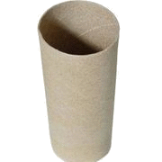
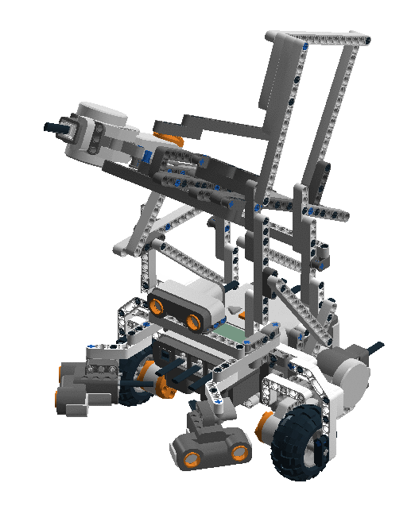

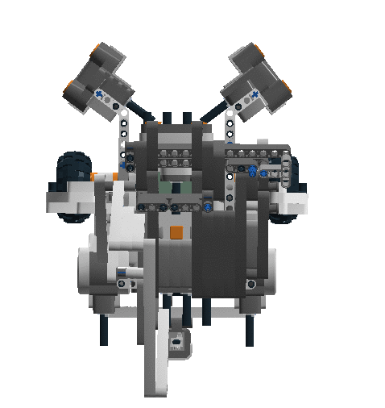
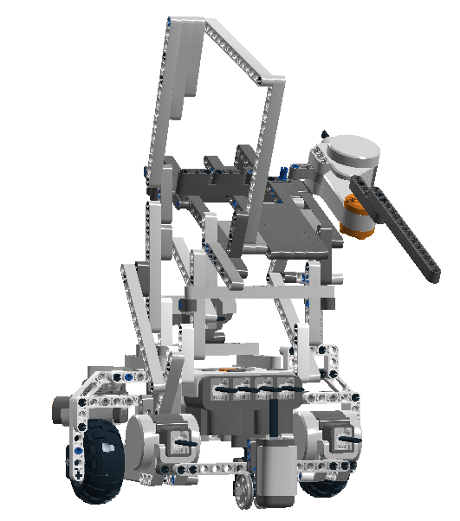
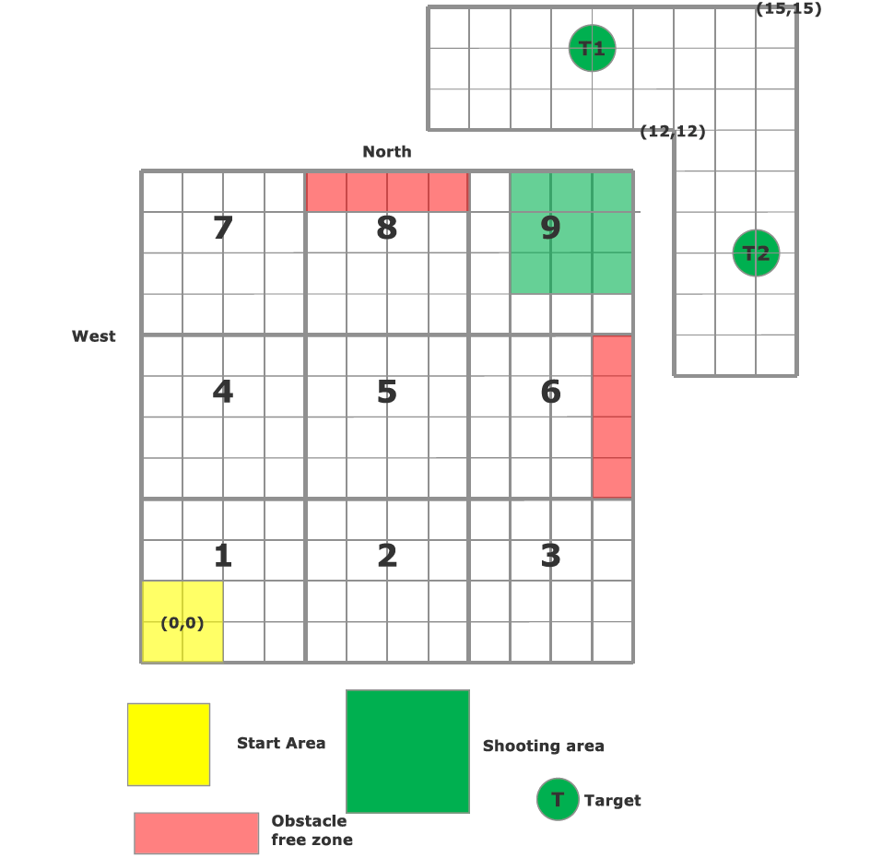
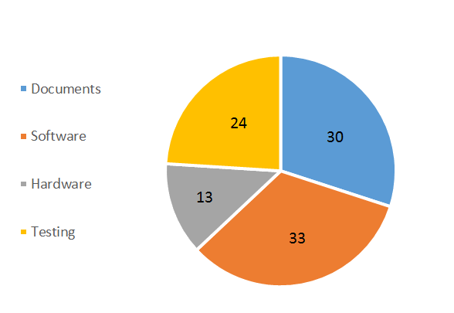


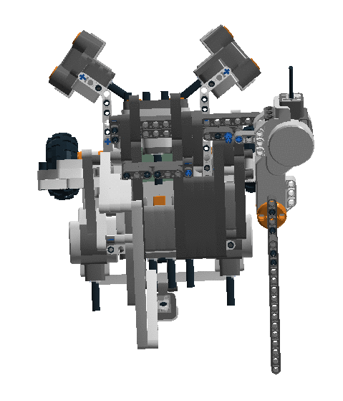

Team 05 - Caffeinator
Team Members: Eric Vuong – Project Manager / Software
Gwen Pang - Documenter Yu Chen Xu – Hardware Manager Adrian Pan – Software Manager
James Fuh – Sofware
Yutian Zheng - Hardware
Objective
Hardware & Software
The objective of this project is to develop an autonomous robot using the Lego Mindstorms Kits. This robot needs to be able to localize anywhere within the start area. It will then travel to the shooting area while avoiding obstacles and shoot at 2 targets with 3 ping-pong balls each. After shooting, it must return to center of the start area (0,0) and face the north.
Built with LEGO Mindstorm Kits and designed in a small, solid and compact structure, Caffeinator is able to accomplish some fantastic tasks by the application of engineering principles.
Software
Flow Chart
Start
Projectile Range: 150 +/- 5 cm
By using the gravity force, the ping-pong balls load automatically one after the other through a cylindrical tube attached to the robot.
Obstacle Avoidance
Competition Floor
Localize
1 Light Sensor
Yes
7
8
9
Travel To Waypoint
Approaching Obstacle?
Obstacles: 30cm cubes
No
No
4
5
6
Area 2, 3, 4, 7: Mapped Obstacles
Area 5, 6, 8: Unmapped Obstacles
Arrived at Destination?
Launch Projectiles
Small Tile: 30cm x 30cm
Obstacles: 30cm x 30cm x 30cm
Target Radius: 7.5cm
1
2
3
3 Ultrasonic Sensors
(0,0)
Yes
2 Motor for flexible Navigation and Odometry
Localize
Travel to Starting Position
By using the rotational force of a LEGO motor, the sticks in dark gray will hit the ball in the resting zone, resulting the launching of the projectile.
Task Distributions
End
Advanced Ultrasonic Localization
Accurate Light Localizer
Safe Obstacle Avoidance Full 180 degrees coverage
Documentation Hardware Software Testing
Caffeinator quickly sweeps its
surrounding and detects for the
closest distance to wall to approximate
its current position using Ultrasonic Sensor.
20 cm
Next, the robot travels to closest intersection
and rotates 360 degreesto detect the 4 grid
lines using light sensor for an accurate
localization of its current position.
86%
310 used /360 alloted hours

